Slide 1

Rapid Optimization Model Development with Python and Pandas
Rob Randall, PhD – Senior Optimization Specialist
Irv Lustig, PhD – Optimization Principal
2022 INFORMS Business Analytics Conference
April 3, 2022

Slide 2






www.princeton.com
Information Technology & Management Consulting
Advanced Analytics
Strategy
Application Development
Process Improvement
2 Research Way
Princeton New Jersey
590 5th Ave
New York City
Transformation through AI and Optimization
Clients: Leading transportation and industrial supply chain organizations
Track Record: 42 years in business under founding leadership; Over 1800 successful completed projects
Experience: Senior Staff (top 28 consultants) average 15+ years; Firm Leadership (6 Directors) average 20+ years experience
Mission: Helping clients Accelerate their Digital Transformation

Slide 3

“Life-Altering” Improvements
“The increase in speed and flexibility from the new model impacts every piece of our business across multiple teams. Now we can strategically invest that time in everything from building more personal customer experiences to optimizing our production process. With this new model, Birchbox has truly entered a new operating universe.”
David Bendes
Vice President of Global Business Technology at Birchbox

Slide 4
Introduction
1. Understand the Data
2. Define and Document Datasets
3. Collect Data from the Client
4. Document Data Transformations
5. Create Model Documentation
6. Code Optimization Model
7. Validate Results and Iterate
Princeton Consultants has developed a 7-step approach that we believe improve the likelihood of success in optimization projects. This approach:
Creates useful documentation
Shortens the overall development time
Improve code maintainability
Provides a natural feedback loop to business requirements

Slide 5
Introduction
The main tools used in the development are python with the pandas library
Python has a rich ecosystem which aids in deployment
Pandas provides a very clean, sparse way of containing and manipulating the data
This is often used in concert with Gurobi’s python interface (gurobipy)
They can also be used with other python APIs
IBM ILOG CPLEX (docplex),
FICO Xpress-MP
Google’s OR Tools (ortools)
Applied to multiple clients and verticals successfully

Slide 6
Example Problem
A client has tasked you with with helping them solve a scheduling problem.
There are a set of tasks to be scheduled
There are a set of resources to schedule the tasks
Tasks have different processing times
There are groups of resources
Each resource has a maximum length of time that they can be actively working on tasks
A Resource has a specific operating cost per time unit
Some tasks cannot be completed by some resources
Each resource group has a minimum and a maximum number of tasks that they need to do in a day
The goal is to minimize the total cost of processing all the tasks

Slide 7
1. Understand the Data
2. Define and Document Datasets
3. Collect Data from the Client
4. Document Data Transformations
5. Create Model Documentation
6. Code Optimization Model
7. Validate Results and Iterate

Slide 8
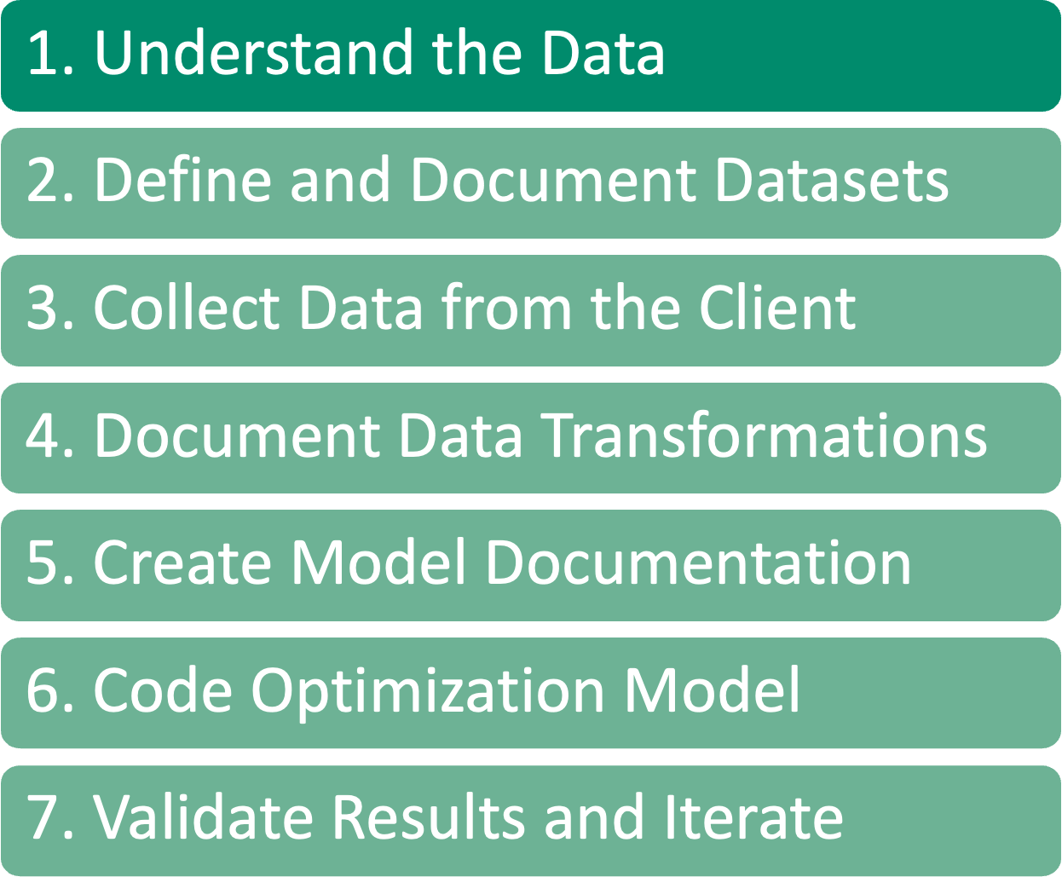
Understand the Data
Understanding the data required is an ABSOLUTE NECESSITY for an optimization project to be successful
For this step work with your clients to understand:
This is the MOST IMPORTANT step in an optimization project, because without a deep understanding of the data available for optimization, we cannot build a good model
Irv is giving a detailed talk on data first modeling on Tuesday morning.
What data is available
The semantic meaning of that data
How they organize that data
How different pieces of data are related to each other

Slide 9
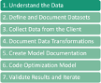
Determining the Available Data
How many times have you (or seen some one who has) built a model, probably a beautiful, elegant model, only to find out that half of the data that you planned to use doesn’t exist?
That’s why before we ever start modeling, we work with our clients to determine what data they have and what state that data is in
Sometime there may be data, but it may be incomplete or inaccurate
This is a key step in determining what type of model can be built

Slide 10
The semantic meaning of that data
Are there universally agreed upon names for data fields?
In my experience there is not, so while one company might call a piece data X, for another that may be Y, and X may be something entirely different.
Another issue can be mismatched units
Column may be named Minutes but the data is saved in Seconds
Therefore, not only do we work with our clients to determine what data is available to model, but to make sure we know what each piece of data means and how it was created.
This generally involves creating a data dictionary so that we have definitions of what each table and each field in those tables represent
This is a good practice for the client to get into as well, as often with turnover there are fields that the client isn’t even always sure the meaning of

Slide 11
How different pieces of data are related to each other
Not only do we need to know how each piece data is defined but need to know how the different pieces of data work together.
Determine relationships and other linking pieces that can be used when building the model
Some of these may determine what variables you can use
And what constraints may need to be built on those relationships

Slide 12
1. Understand the Data
2. Define and Document Datasets
3. Collect Data from the Client
4. Document Data Transformations
5. Create Model Documentation
6. Code Optimization Model
7. Validate Results and Iterate

Slide 13
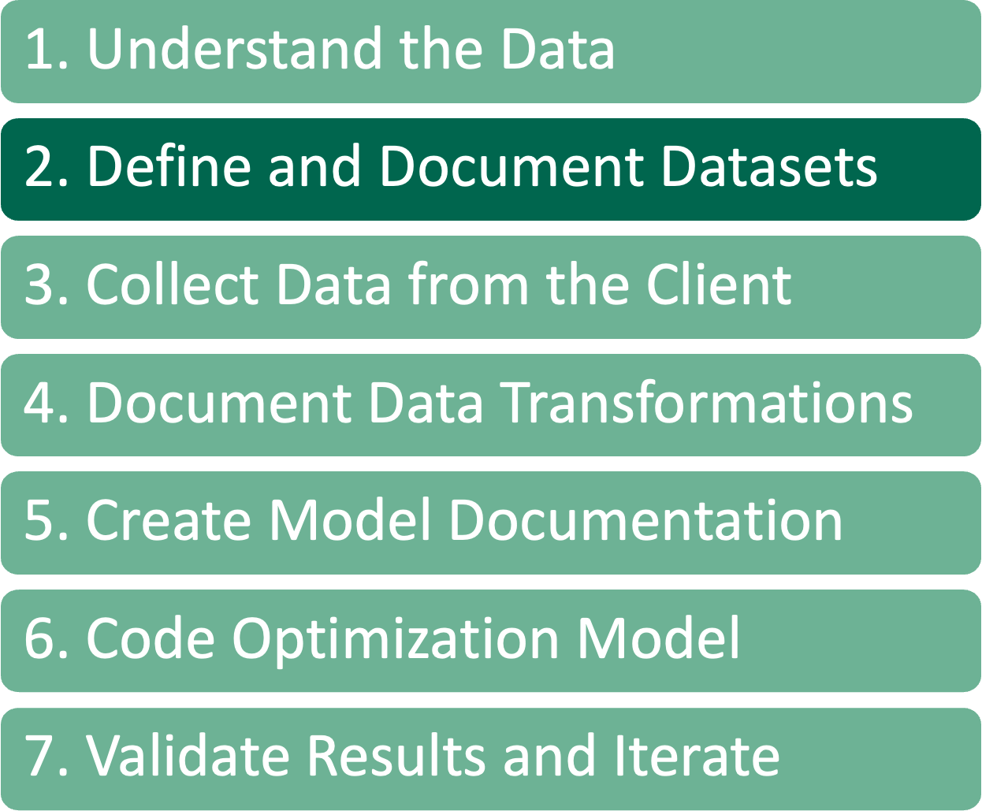
Define and Document Datasets
A format needs to be defined for the client to deliver the datasets in a consistent and meaningful format to the team
We generally use the concept of “tidy data” as a starting point for this format
Columns contain variables, rows contain observations
For more information on ”tidy data” see Irv’s talk on Tuesday
When creating these definitions, we define mathematical notation to represent the data items
Use Markdown where we can include LaTeX notation.
This is generally done in either Visual Studio Code or a Jupyter Notebook
Can export using Pandoc to a distributable (doc, pdf) form
This document is often reviewed with the client

Slide 14
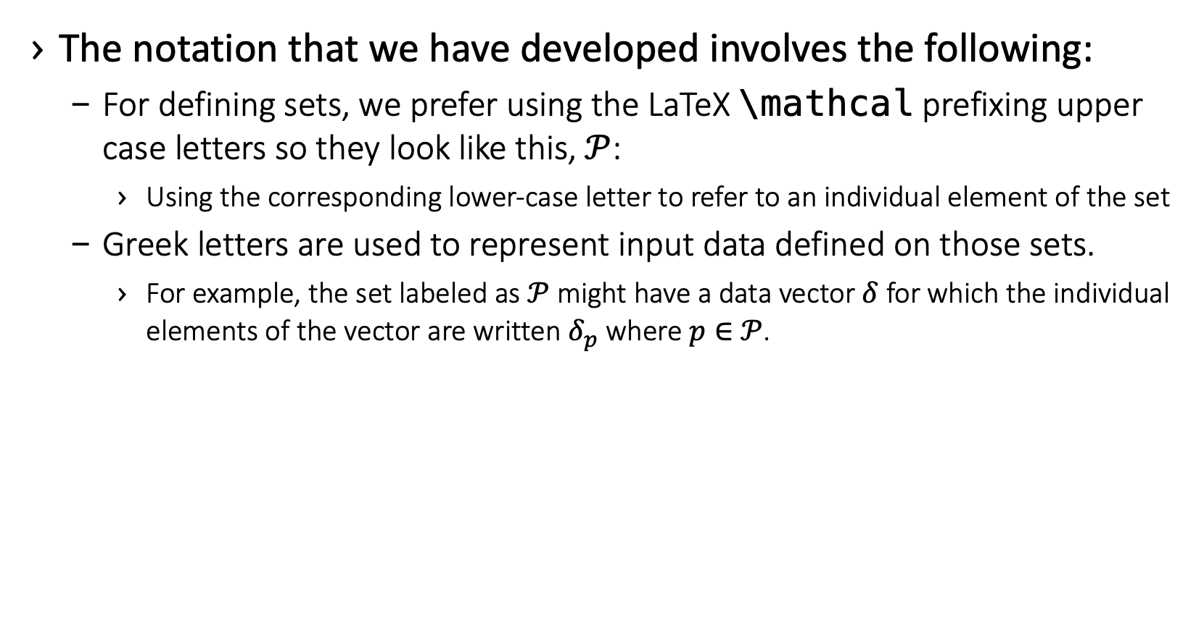
Define and Document Datasets
The notation that we have developed involves the following:
For defining sets, we prefer using the LaTeX \mathcal prefixing upper case letters so they look like this, $𝒫$:
Using the corresponding lower-case letter to refer to an individual element of the set
Greek letters are used to represent input data defined on those sets.
For example, the set labeled as $𝒫$ might have a data vector $δ$for which the individual elements of the vector are written $δ_{p}$ where $p∈$ $𝒫$.

Slide 15
Example – Data Table Documentation
Table
Column
There are a set of tasks to be scheduled
Tasks have different processing times
Tasks
Task – The unique identifier for the task
Time – The task duration, in hours
There are groups of resources
Each resource group has a minimum and a maximum number of tasks that they need to do in a day
ResourceGroups
ResourceGroup – The unique identifier for the resource group
MinTasks – The minimum number of tasks this resource group can perform in a day
MaxTasks – The maximum number of tasks this resource group can perform in a day
A Resource has a specific operating cost per time unit
Resources
Resource – The unique identifier for the resource
There are a set of resources to schedule the tasks
Each resource has a maximum length of time that they can be actively working on tasks
HoursAvailable – The number of hours this resource can be used in a day
CostPerHour – The cost, in dollars, per hour for using this resource
TaskResource
Task – A reference to a Task instance
Some tasks cannot be completed by some resources
The goal is to minimize the total cost of processing all the tasks
Resource – A reference to a Resource that can perform this Task
This is a calculated data transformation, which we’ll talk about later
Cost – The cost to assign a task to a resource

Slide 16
Example – Model Data Documentation
Sets
Let $𝒯$ be the set of tasks that need to be completed.
Tasks table, Task column
Let $𝒢$ be the set of resource groups.
ResourceGroups table, ResourceGroup column
Let $ℛ$ be the set of resources that can complete the tasks.
Resource table, Resource column
Let $𝒬_{r}$ be the set of tasks that resource $r∈ℛ$ can perform.
All values of the Task column in the TaskResource table that have Resource r
Let$𝒫_{t}$ be the resources that task $t∈𝒯$can be scheduled on.
All values of the Resource column in the TaskResource table that have Task t
Let $𝒮_{g}$ be the resources that belong to resource group $g∈𝒢$.
Resource table, ResourceGroup column

Slide 17
Example – Model Data Documentation
Data Inputs
Let $η_{t}>0$ be the number of hours for a task $t∈𝒯$.
Task table, Time column
Let $λ_{r}≥0$ be the cost per hour for a resource $r∈ℛ$.
Resource table, CostPerHour column
Let $γ_{r}≥0$ be the number of hours that a resource $r∈ℛ$ can work in one day.
Resource table, HoursAvailable column
Let $α_{g}≥0$ be the min number of tasks, $t∈𝒯$, that resource group $g∈𝒢$ can work.
ResourceGroup table, MinTasks column
Let $β_{g}≥0$ be the max number of tasks, $t∈𝒯$, that a resource group$g∈𝒢$ can work.
ResourceGroup table, MaxTasks column

Slide 18
1. Understand the Data
2. Define and Document Datasets
3. Collect Data from the Client
4. Document Data Transformations
5. Create Model Documentation
6. Code Optimization Model
7. Validate Results and Iterate

Slide 19

Define and Document Datasets
Generally, comes in one of two ways
Client just dumps their data to us
Work with client to determine our data needs and specify what data to send and the format for that data
All data should be in a tabular format
CSV
Excel with multiple sheets

Slide 20
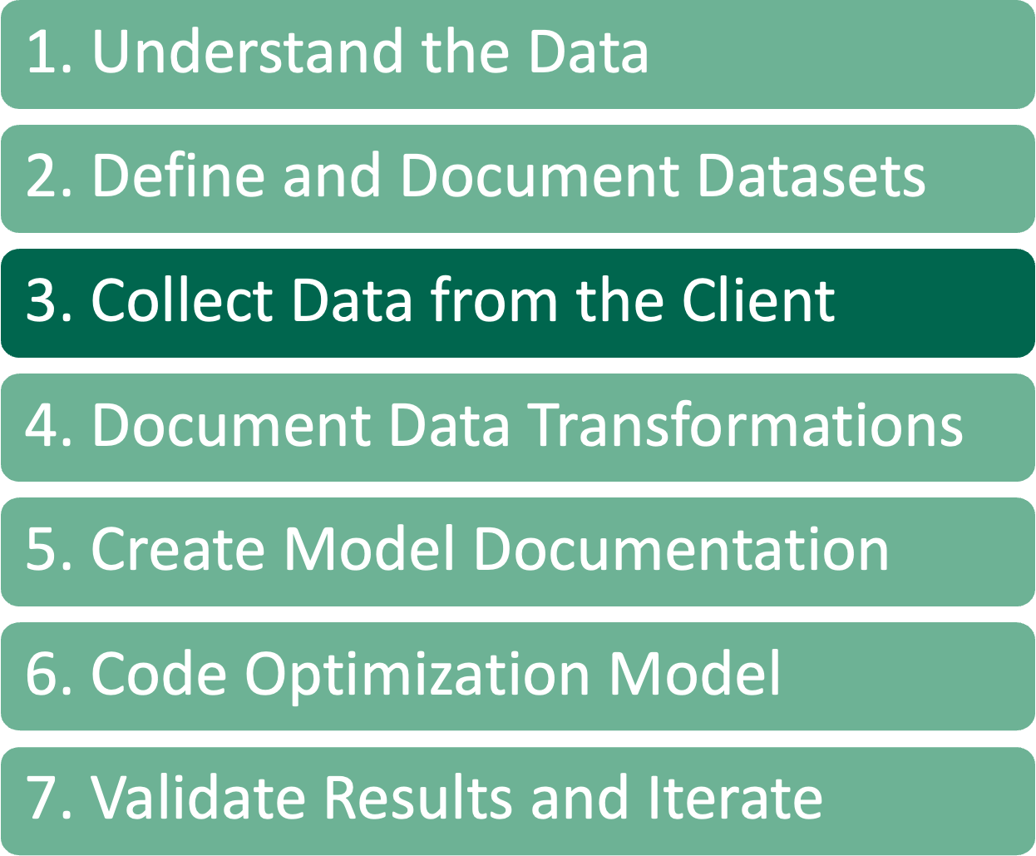
Client Data Dump
When the client dumps data to us, we refer to that as the “raw data format”.
Production data
Not necessarily model friendly
Using Python and Pandas, transform this data to a format that’s model friendly, the “model data format”
Calendar dates transformed to discrete periods
Dropping unnecessary data
Combining multiple production tables into data tables we’ve defined

Slide 21
Use Created Data Tables
Client uses the data tables we create to feed data to us
This is the best way for us, which means it almost never happens
Cuts down on the data passed and work we do, since the data matches our tables
Still may need some processing
Calendar to discrete periods

Slide 22
Collect Data From the Client
As we work on this code, sometimes we must update our documentation of the tidy data format that we are expecting
This is a living document
Update based on new understanding
When new data is added for features
Once the input data to the model has been defined there should be some data validation tests added.
This will help prevent data issues that pop up in production and “break” the model.
Not going to catch them all
Continue refining throughout project

Slide 23
Example – Data Validations
What are some validations that should be added for this model?
Do this in terms of data definitions, doesn’t have to be an optimization person who codes this
Ensure no task takes longer than a resource can work
Ensure every task can be done by at least one resource
The total resource hours available exceeds the total task work hours required
Ensure there are enough tasks that can be assigned to resources in each resource group to meet the minimum number of tasks for that group
Ensure that the total number of tasks that can be performed by all resource groups exceed the number of input tasks

Slide 24
1. Understand the Data
2. Define and Document Datasets
3. Collect Data from the Client
4. Document Data Transformations
5. Create Model Documentation
6. Code Optimization Model
7. Validate Results and Iterate

Slide 25
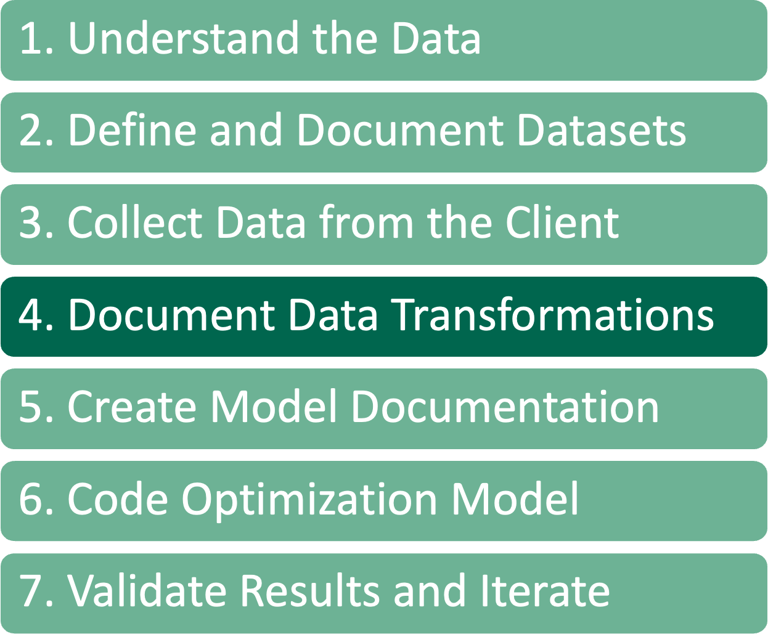
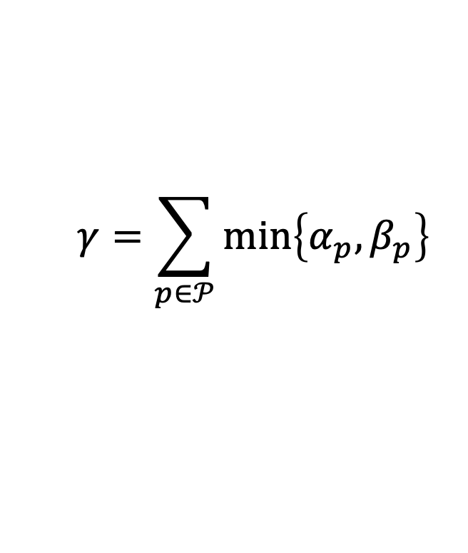
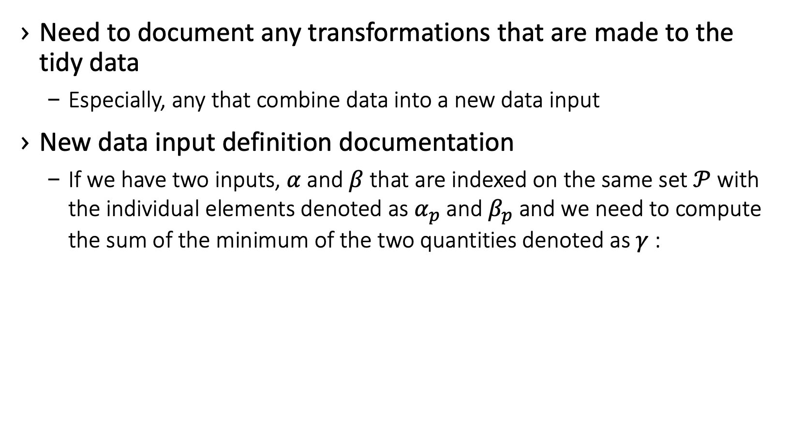
Document Data Transformations
Need to document any transformations that are made to the tidy data
Especially, any that combine data into a new data input
New data input definition documentation
If we have two inputs, $α$ and $β$ that are indexed on the same set $𝒫$ with the individual elements denoted as $α_{p}$ and $β_{p}$ and we need to compute the sum of the minimum of the two quantities denoted as $γ$ :
$$γ=\sum_{p∈𝒫}{min⁡\left\{α_{p},β_{p}\right\}}$$

Slide 26
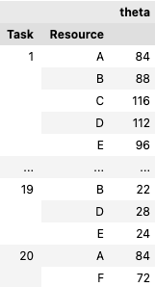
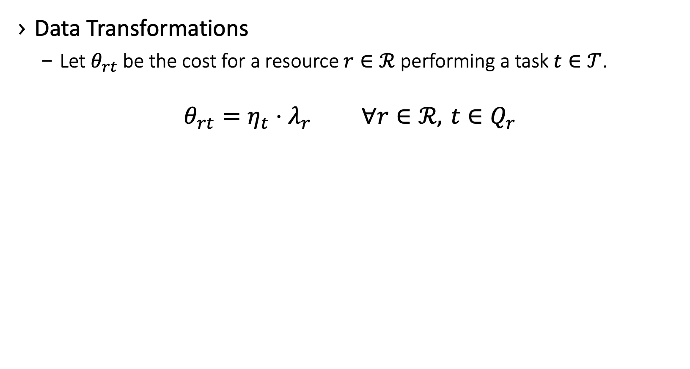
Example
Data Transformations
Let $θ_{rt}$ be the cost for a resource $r∈ℛ$ performing a task $t∈𝒯$.
$$θ_{rt}=η_{t}⋅λ_{r} ∀r∈ℛ, t∈Q_{r}$$
Task | Resource
1 | A
1 | B
1 | C
1 | D
1 | E
2 | D
2 | E
2 | F
3 | E
4 | A
4 | B
4 | C
4 | D
5 | B
Task | Time
1 | 2
2 | 3
3 | 2
4 | 3
Resource | Cost
A | 29
B | 26
C | 25
D | 26
E | 17
F | 22

Slide 27
1. Understand the Data
2. Define and Document Datasets
3. Collect Data from the Client
4. Document Data Transformations
5. Create Model Documentation
6. Code Optimization Model
7. Validate Results and Iterate

Slide 28
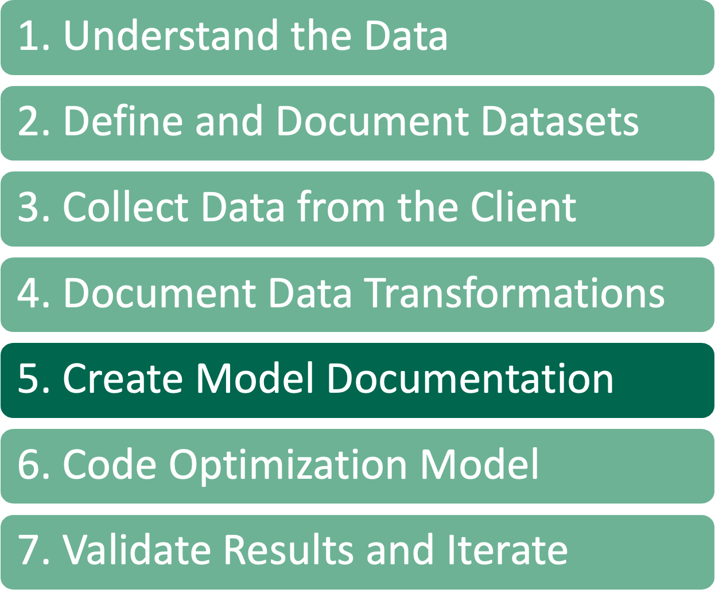
Create Model Documentation
Now that the data inputs and transformations are documented, we can write a document that describes the optimization model that we will build. This includes:
Decision variables
Our convention is to use a single lower-case English letter for a decision variable
The sets that describe these variables are listed using subscripts
Constraints
Add constraints to the model one at a time to allow for constant model testing
Objective function(s)
A multi-objective model, or
Allow users to choose from multiple objectives

Slide 29
Create Model Documentation
Each item is also described in “Plain English” to ensure an understanding of what the model is trying to accomplish
Auditability
Show understanding of rules to business
Create an Optimization Business Logic Document, that is shared specifically with business users
Used to create a solution checker

Slide 30
Example Problem
A client has tasked you with with helping them solve a scheduling problem.
There are a set of tasks to be scheduled
There are a set of resources to schedule the tasks
Tasks have different processing times
There are groups of resources
Each resource has a maximum length of time that they can be actively working on tasks
A Resource has a specific operating cost per time unit
Some tasks cannot be completed by some resources
Each resource group has a minimum and a maximum number of tasks that they need to do in a day
The goal is to minimize the total cost of processing all the tasks

Slide 31
Example Problem
Let’s try and characterize the requirements.
Decisions
Assign tasks to resources
Determine the number of tasks scheduled on a group of resources
Rules
Each task must be scheduled
Each resource has a maximum length of time they can be actively working on tasks
Each resource group has a minimum and a maximum number of tasks that they need to do in a day
Goals
Minimize the total cost of processing all the tasks

Slide 32
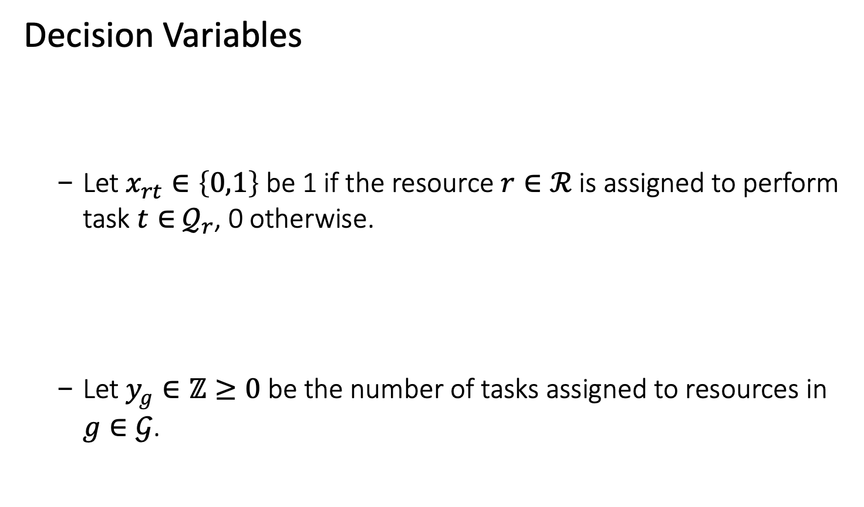
Example – Model Documentation
Decision Variables
Let $x_{rt}∈\left\{0,1\right\}$ be 1 if the resource $r∈ℛ$ is assigned to perform task $t∈$ $𝒬_{r}$, 0 otherwise.
Let $y_{g}∈ℤ≥0$ be the number of tasks assigned to resources in $g∈𝒢$.
There are a set of tasks to be scheduled on a set of resources
Determine the number of tasks scheduled by a group of resources

Slide 33
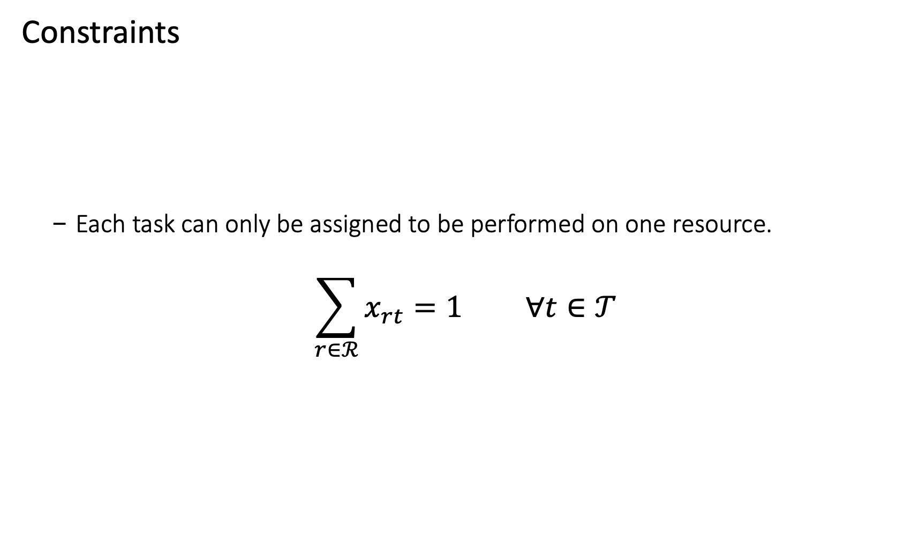
Example – Model Documentation
Constraints
Each task can only be assigned to be performed on one resource.
$$\sum_{r∈ℛ}^{​}{x_{rt}}=1 ∀t∈𝒯$$
Each task must be scheduled

Slide 34
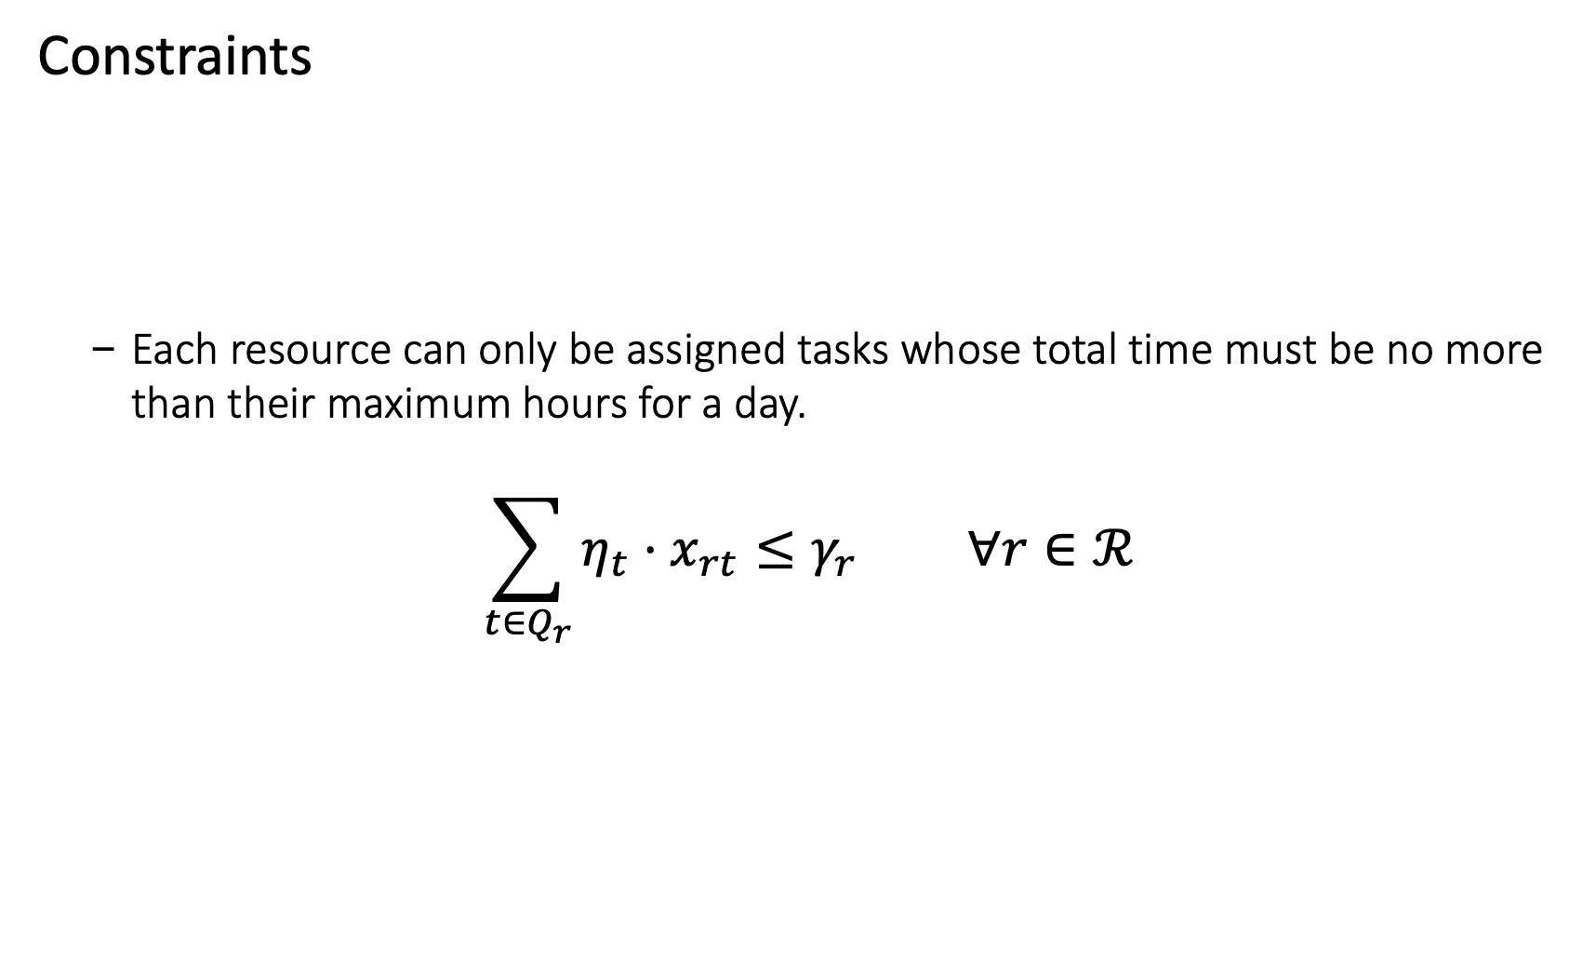
Example – Model Documentation
Constraints
Each resource can only be assigned tasks whose total time must be no more than their maximum hours for a day.
$$\sum_{t∈Q_{r}}^{​}{η_{t}}⋅x_{rt}≤γ_{r} ∀r∈ℛ$$
Each resource has a maximum length of time they can be actively working on tasks

Slide 35
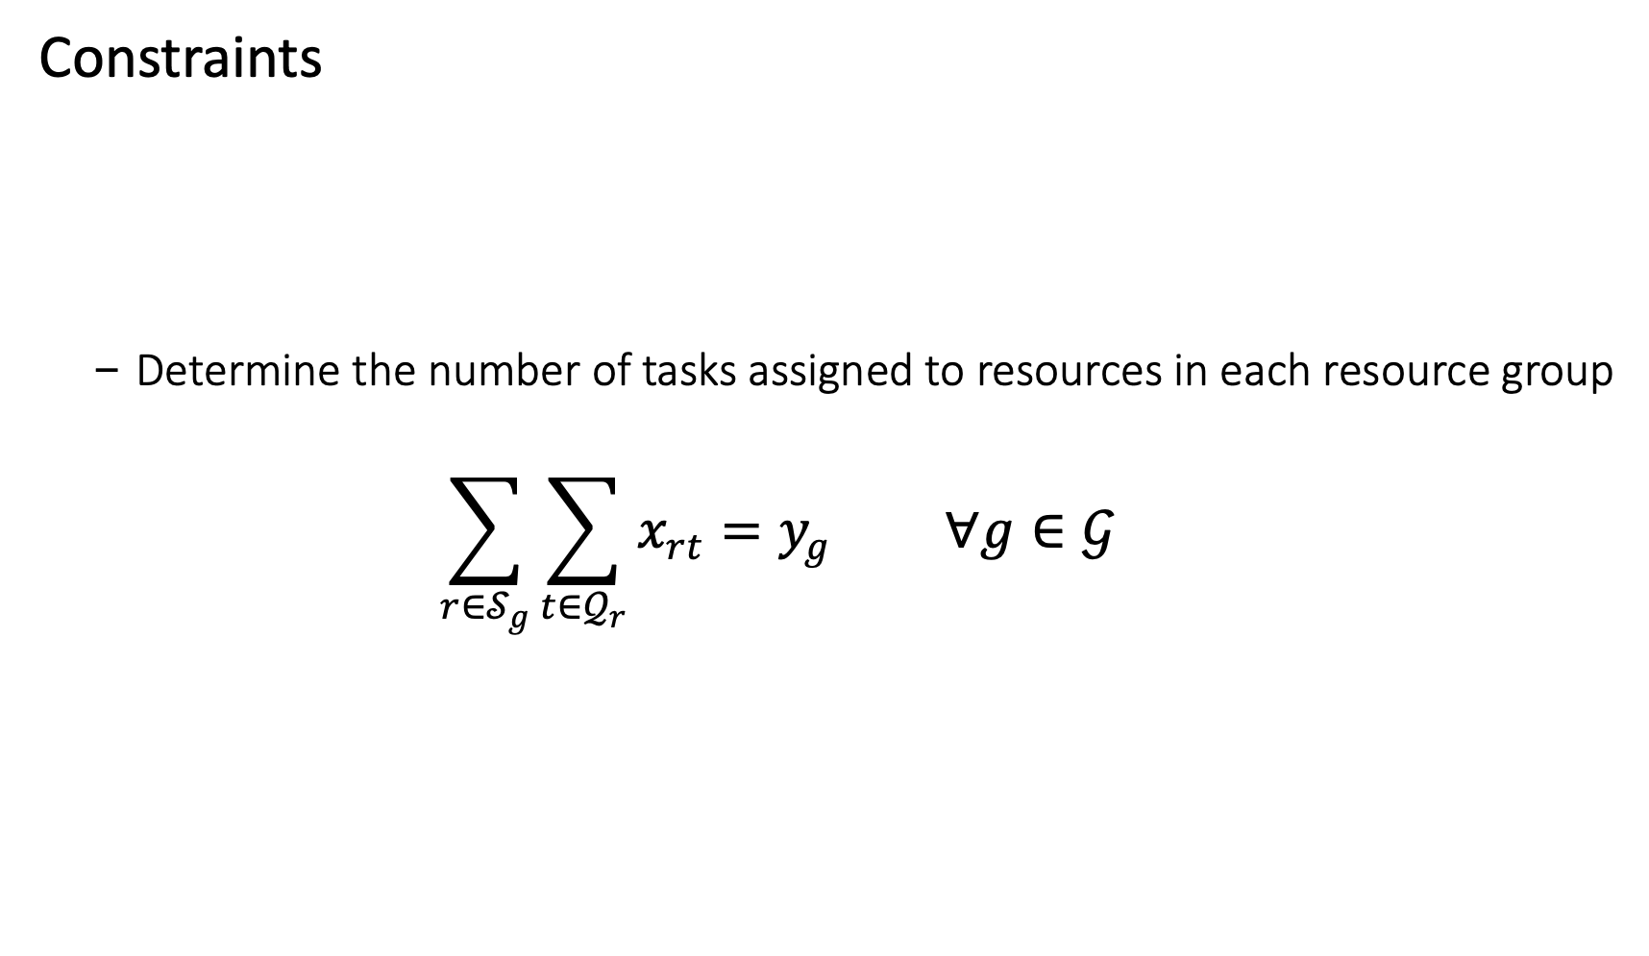
Example – Model Documentation
Constraints
Determine the number of tasks assigned to resources in each resource group
$$\sum_{r∈𝒮_{g}}^{​}{\sum_{t∈𝒬_{r}}^{​}{x_{rt}}}=y_{g} ∀g∈𝒢$$
Each resource group has a minimum and a maximum number of tasks that they need to do in a day

Slide 36
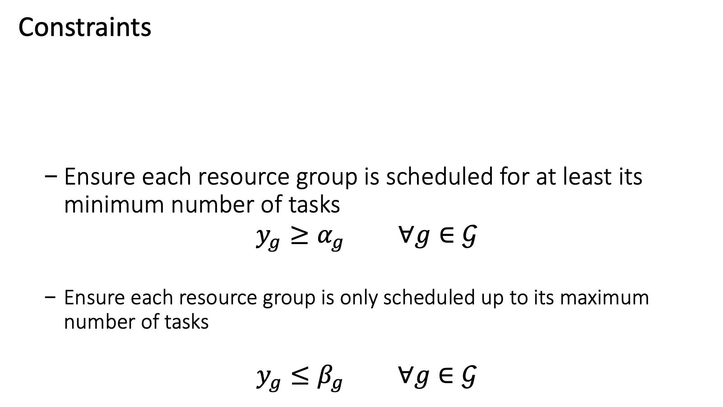
Example – Model Documentation
Constraints
Ensure each resource group is scheduled for at least its minimum number of tasks
$$y_{g}≥α_{g} ∀g∈𝒢$$
Ensure each resource group is only scheduled up to its maximum number of tasks
$$y_{g}≤β_{g} ∀g∈𝒢$$
Each resource group has a minimum and a maximum number of tasks that they need to do in a day

Slide 37
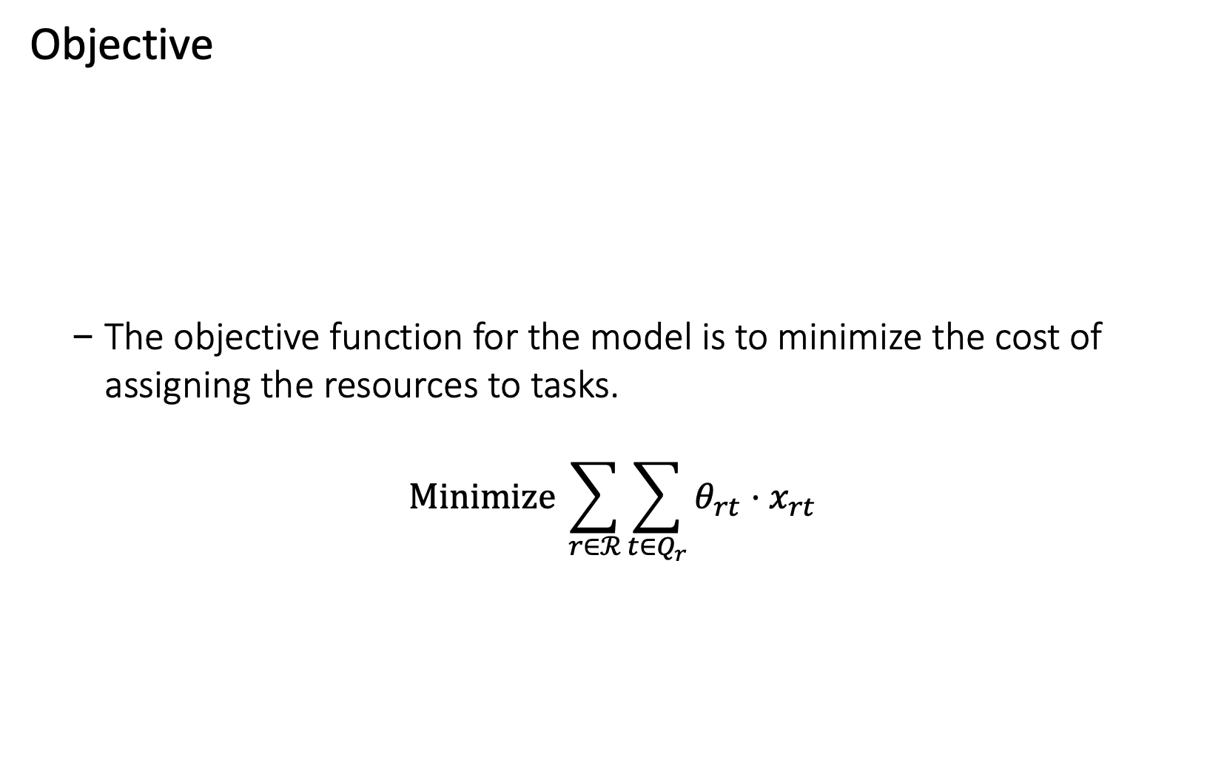
Example – Model Documentation
Objective
The objective function for the model is to minimize the cost of assigning the resources to tasks.
$$Minimize \sum_{r∈ℛ}^{​}{\sum_{t∈Q_{r}}^{​}{θ_{rt}}}⋅x_{rt}$$
Minimize the total cost of processing all the tasks

Slide 38
1. Understand the Data
2. Define and Document Datasets
3. Collect Data from the Client
4. Document Data Transformations
5. Create Model Documentation
6. Code Optimization Model
7. Validate Results and Iterate

Slide 39
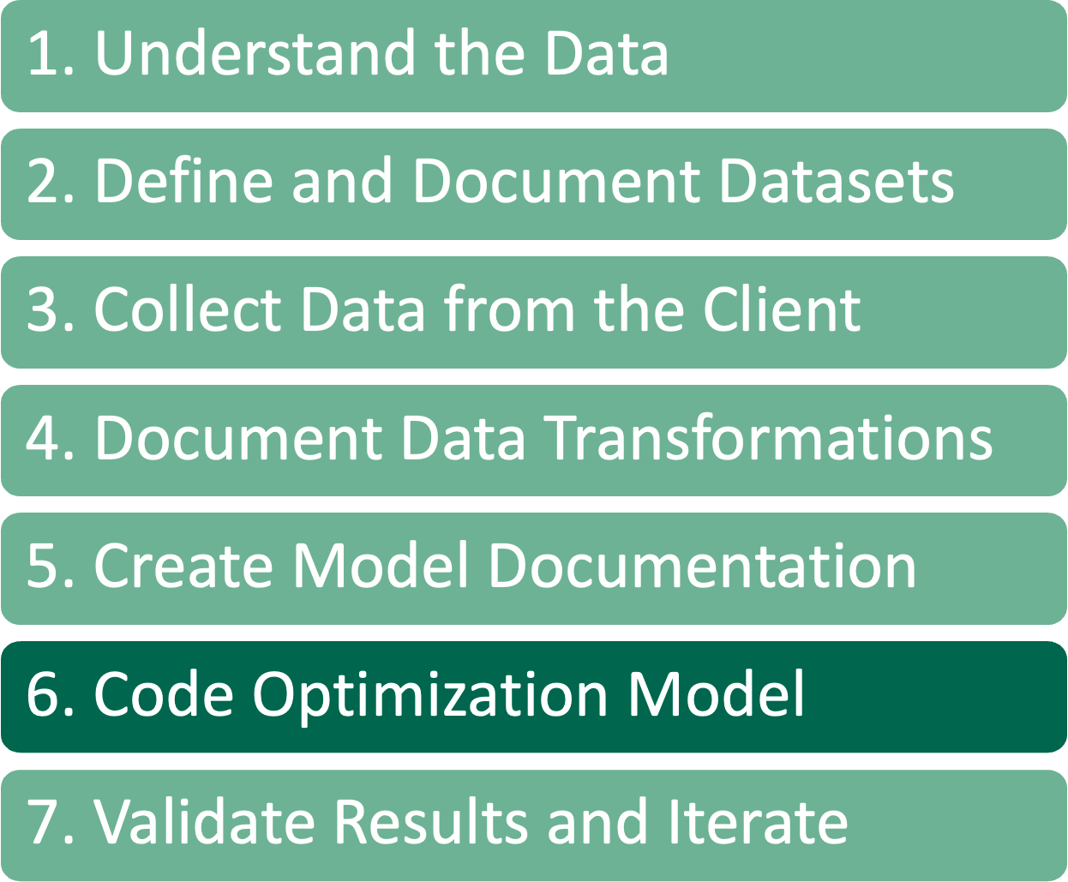
Code Optimization Model
Data inputs and transformations are documented, created a formulation that we believe solves the problem for the client
Now we FINALLY start writing code for the model.
For complicated models, often start with a prototype in a Jupyter Notebook.
This allows for rapid testing to ensure that the model is built correctly
Then we can take the prototype and convert it into a class object that can be integrated into whatever system we’re building
Add a single constraint at a time, continuously testing the model
Often, we use a RESTful service endpoint that receives data for an instance of the model.
Model can be created and tested without the service
Allows for more parallel development
This is a wrapper that takes data in and passes that data to the model code
Believe in separating the model code from the service

Slide 40
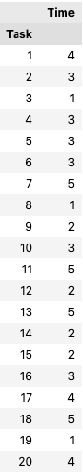
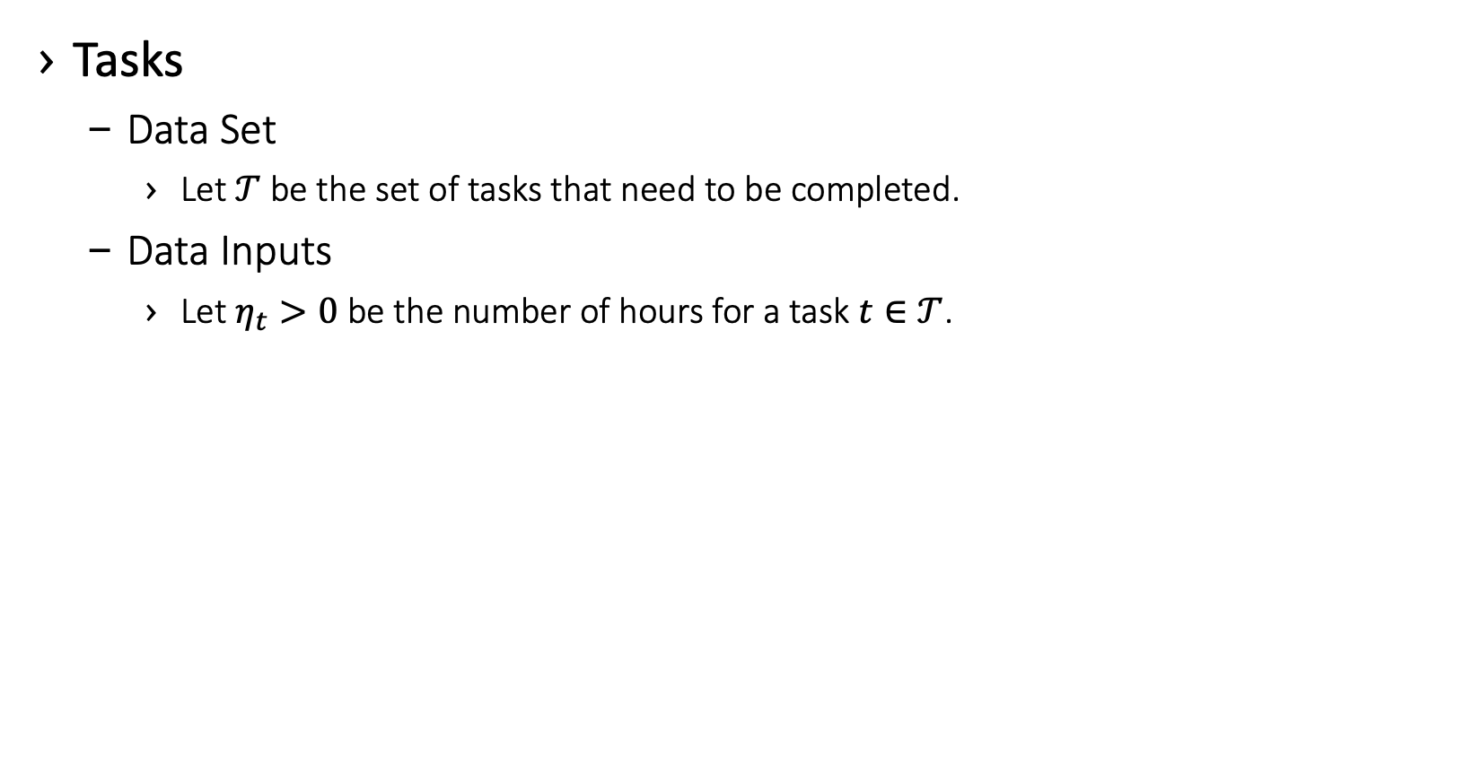
Example – Code Optimization Model
Tasks
Data Set
Let $𝒯$ be the set of tasks that need to be completed.
Data Inputs
Let $η_{t}>0$ be the number of hours for a task $t∈𝒯$.
tasks = pd.read_excel("../data/data.xlsx",
sheet_name="Tasks",
index_col=0)

Slide 41
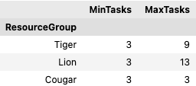
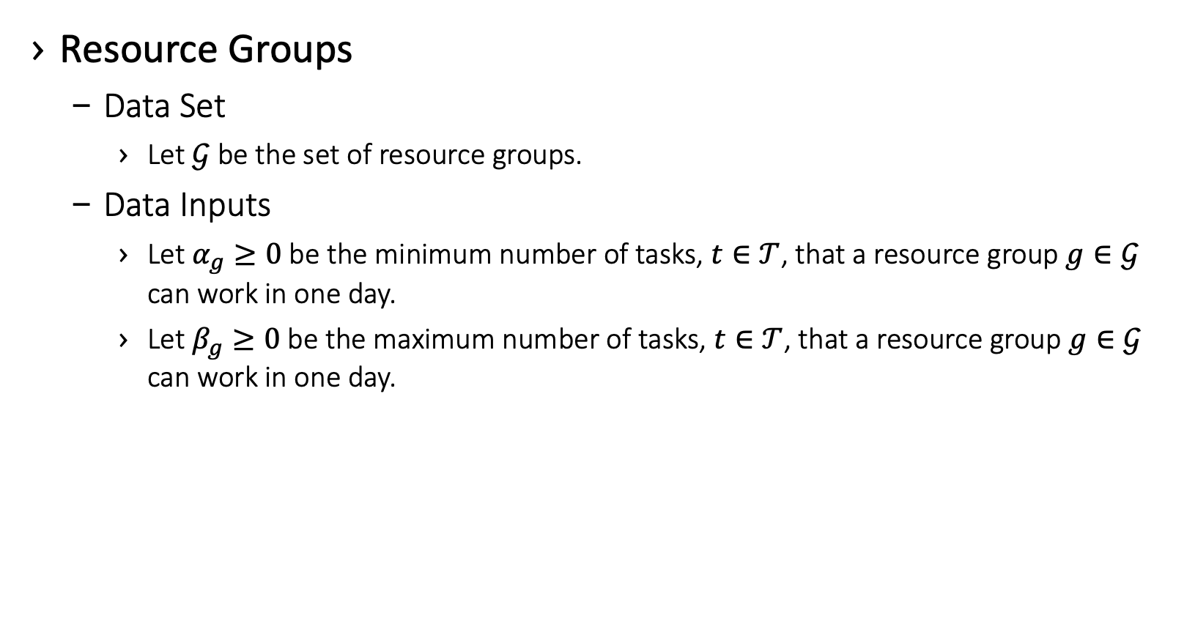
Example – Code Optimization Model
Resource Groups
Data Set
Let $𝒢$ be the set of resource groups.
Data Inputs
Let $α_{g}≥0$ be the minimum number of tasks, $t∈𝒯$, that a resource group $g∈𝒢$ can work in one day.
Let $β_{g}≥0$ be the maximum number of tasks, $t∈𝒯$, that a resource group$g∈𝒢$ can work in one day.
resource_groups = pd.read_excel("../data/data.xlsx",
sheet_name='Resource Groups’,
index_col=0)

Slide 42
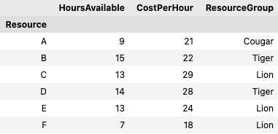
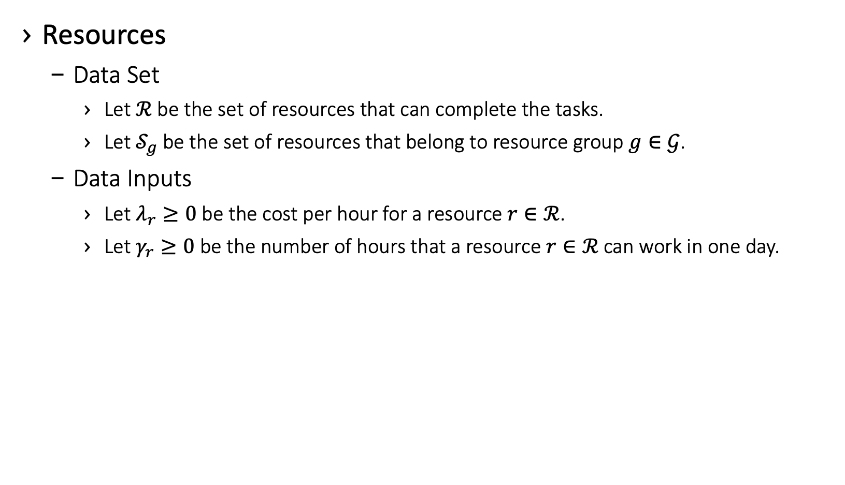
Example – Code Optimization Model
Resources
Data Set
Let $ℛ$ be the set of resources that can complete the tasks.
Let $𝒮_{g}$ be the set of resources that belong to resource group $g∈𝒢$.
Data Inputs
Let $λ_{r}≥0$ be the cost per hour for a resource $r∈ℛ$.
Let $γ_{r}≥0$ be the number of hours that a resource $r∈ℛ$ can work in one day.
resources = pd.read_excel("../data/data.xlsx",
sheet_name='Resources’,
index_col=0)

Slide 43
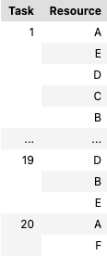
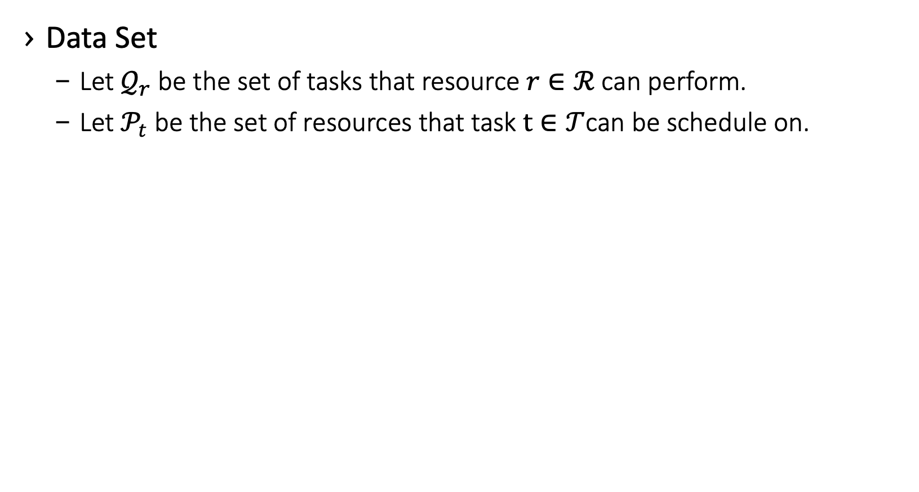
Example – Code Optimization Model
Data Set
Let $𝒬_{r}$ be the set of tasks that resource $r∈ℛ$ can perform.
Let$𝒫_{t}$ be the set of resources that task $t∈𝒯$can be schedule on.
res_task = pd.read_excel("../data/data.xlsx”,
sheet_name='Tasks For Resources’,
index_col=[0,1])

Slide 44
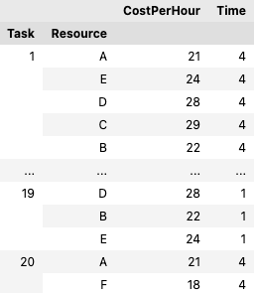
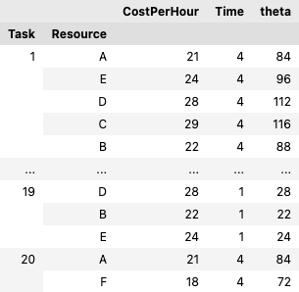
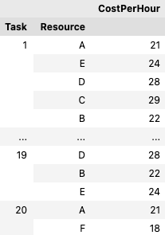
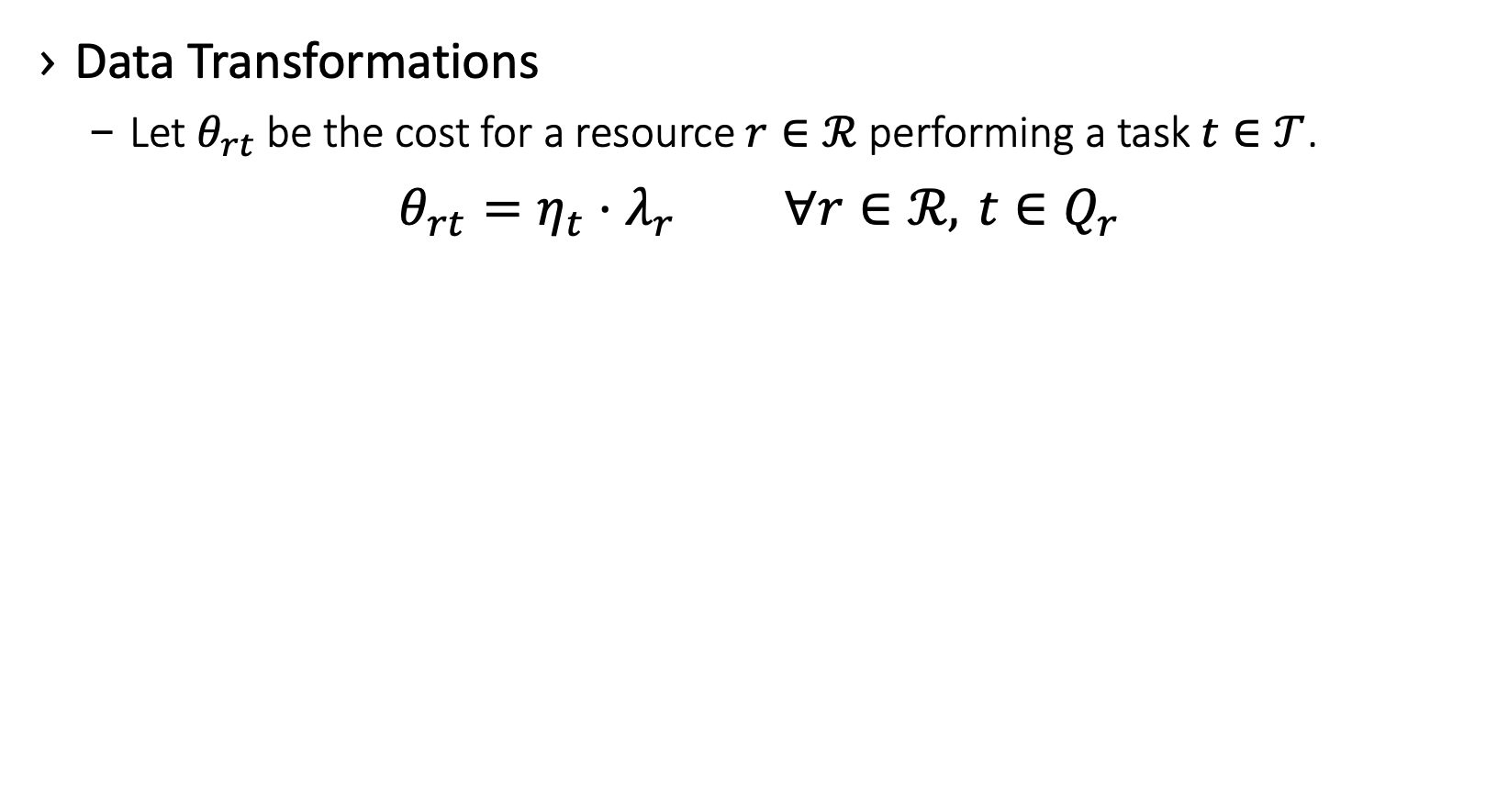
Example – Code Optimization Model
Data Transformations
Let $θ_{rt}$ be the cost for a resource $r∈ℛ$ performing a task $t∈𝒯$.
$$θ_{rt}=η_{t}⋅λ_{r} ∀r∈ℛ, t∈Q_{r}$$
theta = (
res_task .merge(resources[["CostPerHour"]],
how="left”, left_on="Resource",
right_index=True)
.merge(tasks[["Time"]], how="left",
left_on="Task", right_index=True)
.assign(theta=lambda df:
df["CostPerHour"] * df["Time"])
["theta"]
)

Slide 45
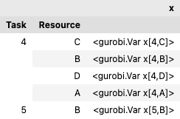
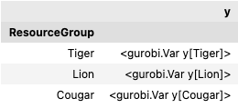
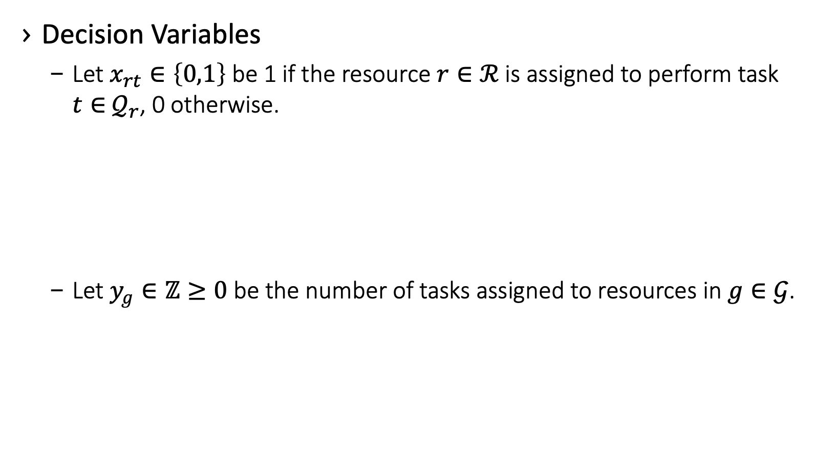
Example – Code Optimization Model
Decision Variables
Let $x_{rt}∈\left\{0,1\right\}$ be 1 if the resource $r∈ℛ$ is assigned to perform task $t∈$ $𝒬_{r}$, 0 otherwise.
Let $y_{g}∈ℤ≥0$ be the number of tasks assigned to resources in $g∈𝒢$.
x = pd.Series(
m.addVars(res_task.index, vtype=grb.GRB.BINARY,
name="x"),
index=res_task.index, name="x”
)
y = pd.Series(
m.addVars(resource_groups.index,
vtype=grb.GRB.INTEGER,
name="y"),
index=resource_groups.index, name="y"
)

Slide 46
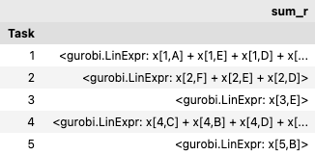
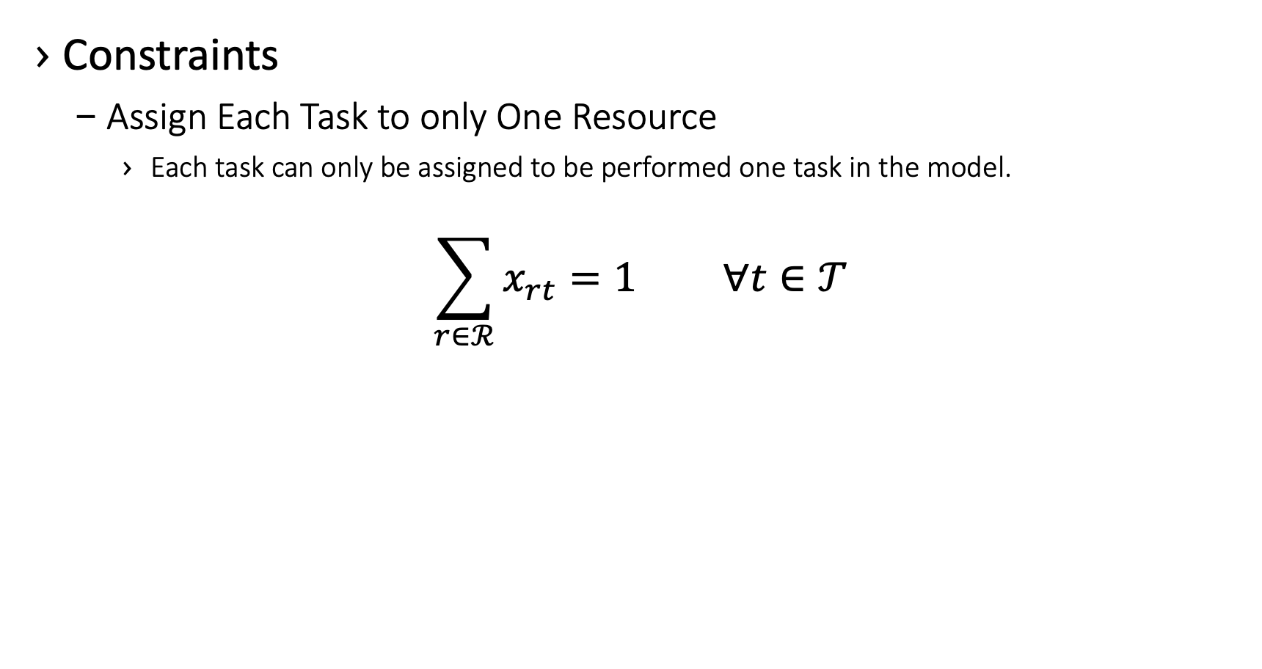
Example – Code Optimization Model
Constraints
Assign Each Task to only One Resource
Each task can only be assigned to be performed one task in the model.
$$\sum_{r∈ℛ}^{​}{x_{rt}}=1 ∀t∈𝒯$$
df = x.groupby('Task').agg(grb.quicksum)
for ind, sum_r in df.items():
m.addConstr(sum_r == 1,
name=namer(
"AllTasksMustBeScheduled",
ind))

Slide 47
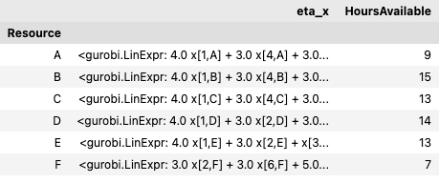
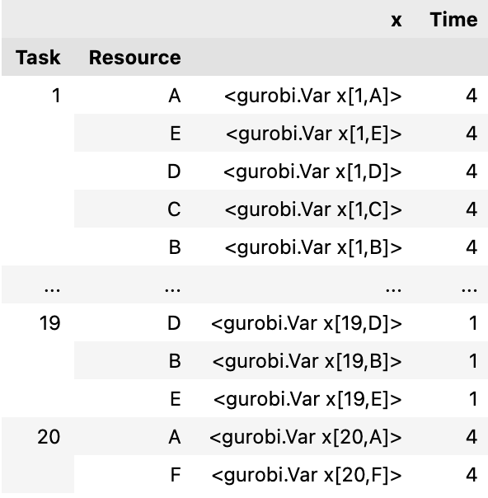
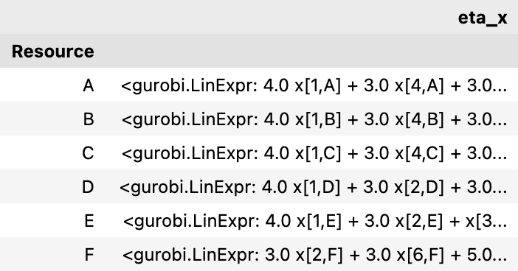
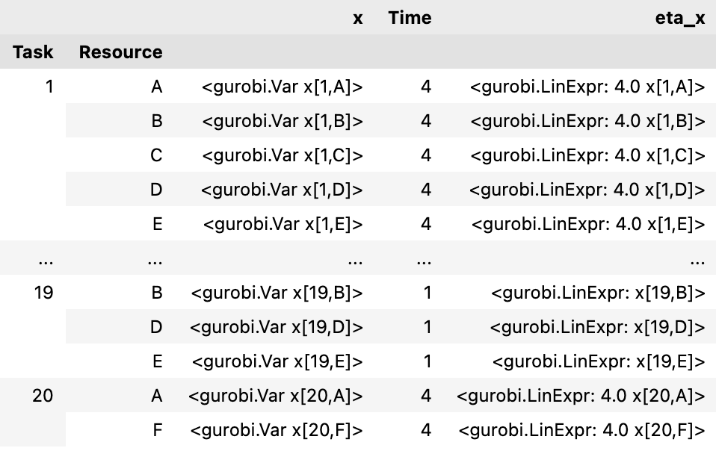
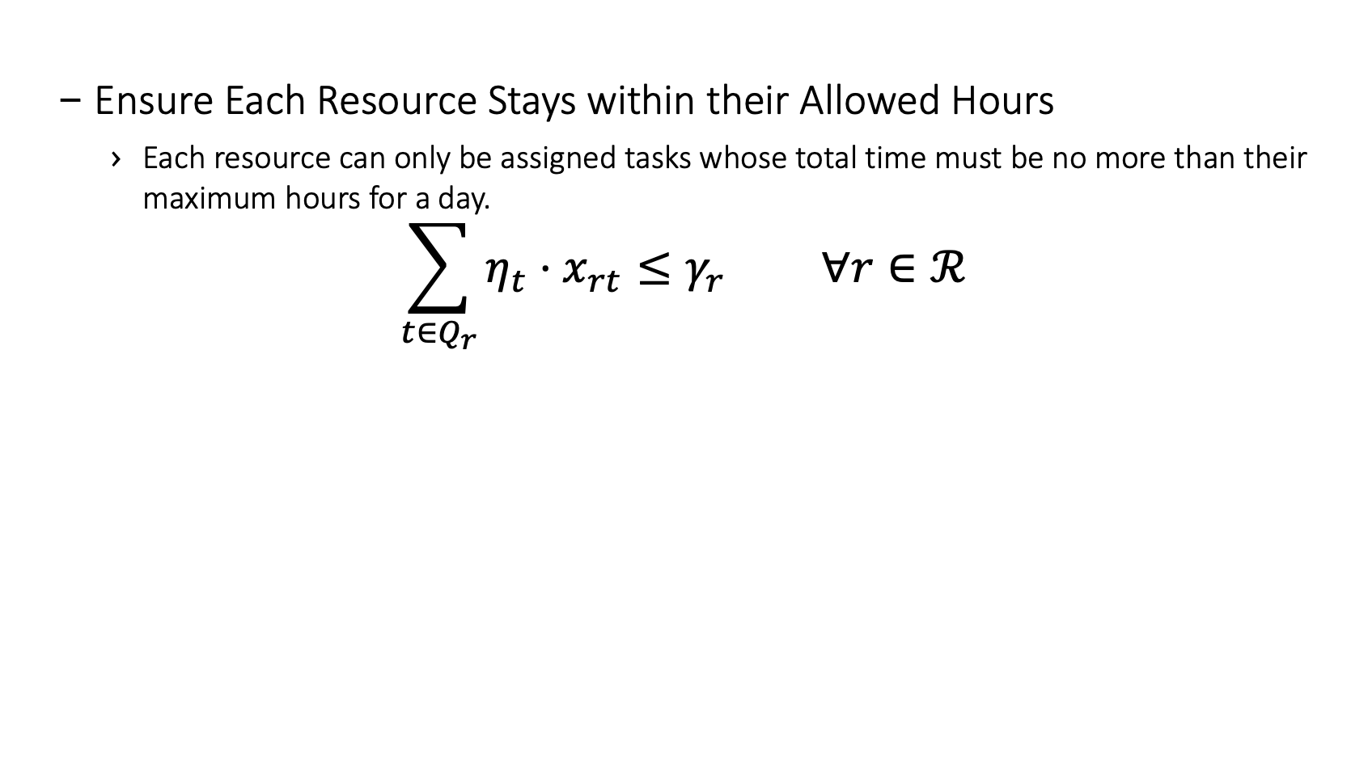
Example – Code Optimization Model
Ensure Each Resource Stays within their Allowed Hours
Each resource can only be assigned tasks whose total time must be no more than their maximum hours for a day.
$$\sum_{t∈Q_{r}}^{​}{η_{t}}⋅x_{rt}≤γ_{r} ∀r∈ℛ$$
df = pd.concat(
[
pd.merge(x, tasks["Time"],
how="left", left_on="Task",
right_index=True)
.assign(eta_x=lambda df:
df["Time"] * df["x"])
.groupby(["Resource"])
["eta_x"]
.agg(grb.quicksum),
resources["HoursAvailable"],
],
axis=1)
for it in df.itertuples():
m.addConstr(
it.eta_x <= it.HoursAvailable,
name=namer("ResourceCantExceedHours",
it.Index))

Slide 48
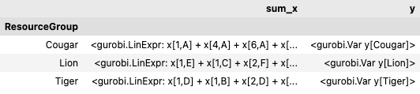
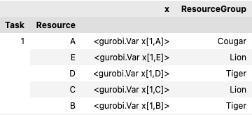
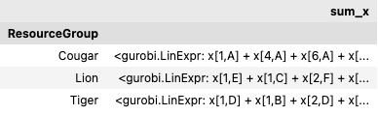
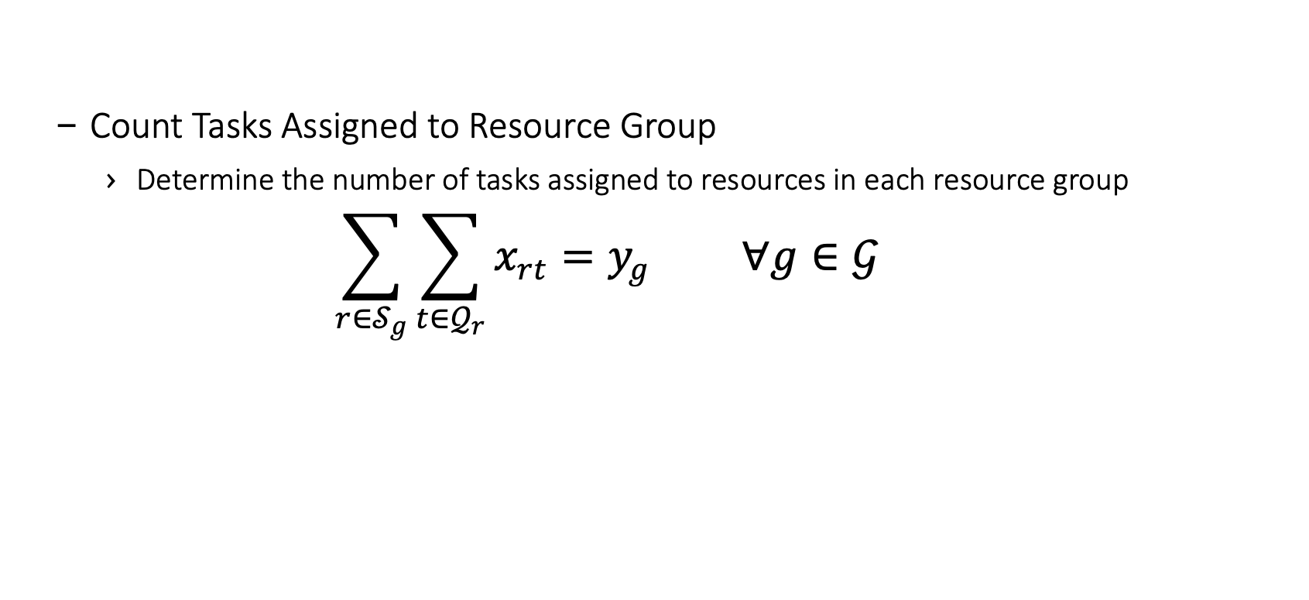
Example – Code Optimization Model
Count Tasks Assigned to Resource Group
Determine the number of tasks assigned to resources in each resource group
$$\sum_{r∈𝒮_{g}}^{​}{\sum_{t∈𝒬_{r}}^{​}{x_{rt}}}=y_{g} ∀g∈𝒢$$
df = pd.concat(
[
pd.merge(x, resources["ResourceGroup"],
how="left",
left_on="Resource",
right_index=True,
)
.groupby("ResourceGroup")["x"]
.agg(sum_x=grb.quicksum),
y,
], axis=1)
for it in df.itertuples():
m.addConstr(it.sum_x == it.y,
name=namer(
"CountTasksForGroup",
it.Index))

Slide 49
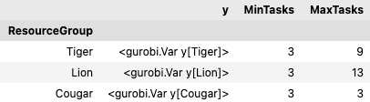
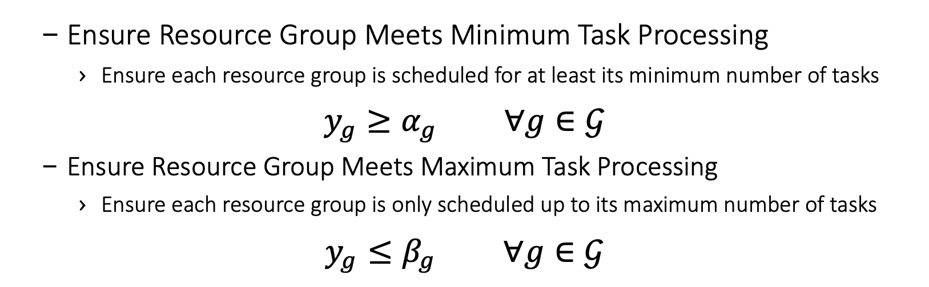
Example – Code Optimization Model
Ensure Resource Group Meets Minimum Task Processing
Ensure each resource group is scheduled for at least its minimum number of tasks
$$y_{g}≥α_{g} ∀g∈𝒢$$
Ensure Resource Group Meets Maximum Task Processing
Ensure each resource group is only scheduled up to its maximum number of tasks
$$y_{g}≤β_{g} ∀g∈𝒢$$
df = pd.concat([y, resource_groups], axis=1)
for it in df.itertuples():
m.addConstr(it.y >= it.MinTasks,
name=namer("GroupMeetsMinTasks",
it.Index))
m.addConstr(it.y <= it.MaxTasks,
name=namer("GroupMeetsMaxTasks", it.Index))

Slide 50
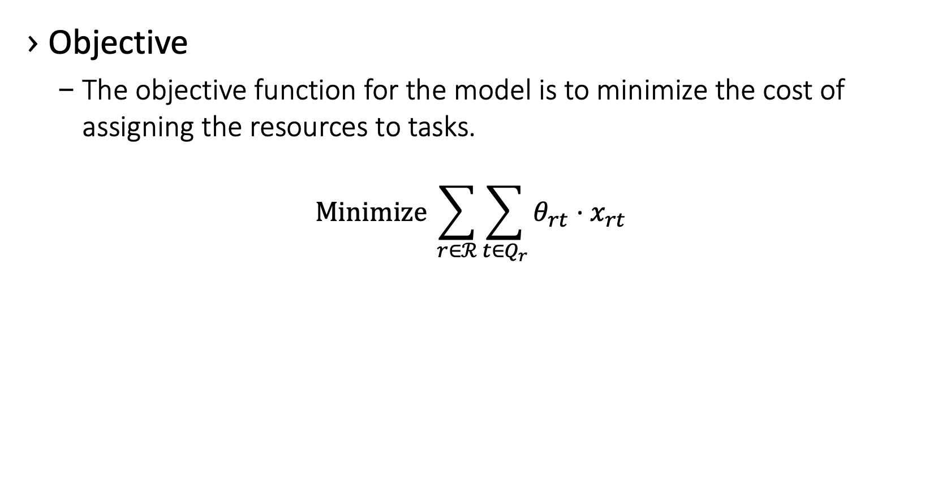
Example – Code Optimization Model
Objective
The objective function for the model is to minimize the cost of assigning the resources to tasks.
$$Minimize \sum_{r∈ℛ}^{​}{\sum_{t∈Q_{r}}^{​}{θ_{rt}}}⋅x_{rt}$$
z = grb.quicksum(theta * x)
m.setObjective(z, grb.GRB.MINIMIZE)

Slide 51
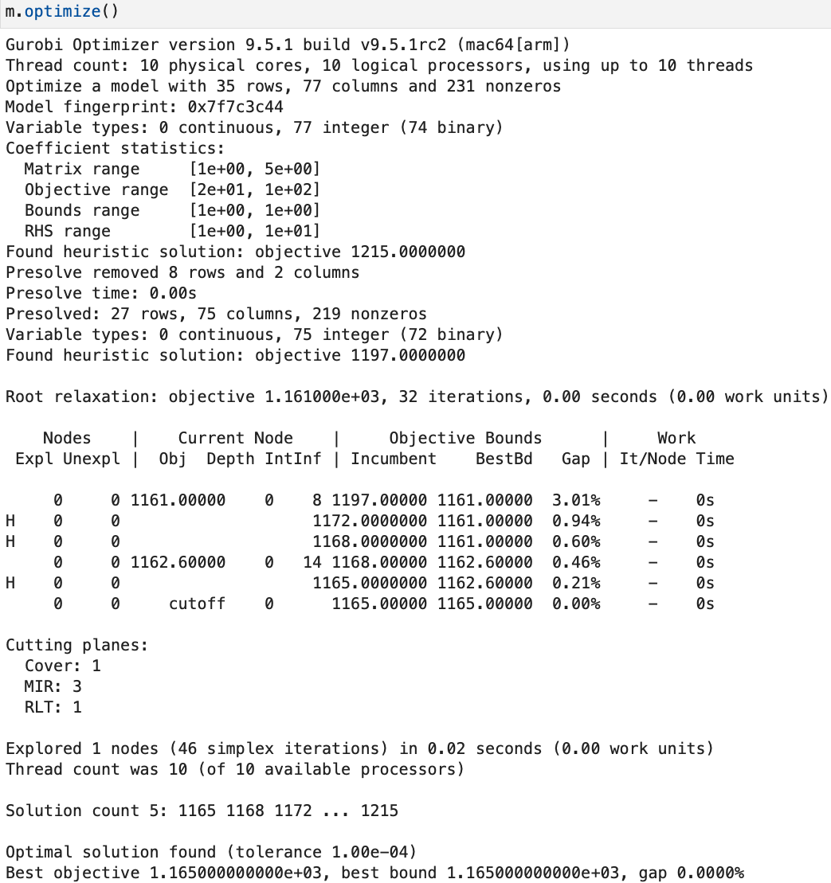
Example – Code Optimization Model
Run the model with Gurobi

Slide 52
1. Understand the Data
2. Define and Document Datasets
3. Collect Data from the Client
4. Document Data Transformations
5. Create Model Documentation
6. Code Optimization Model
7. Validate Results and Iterate

Slide 53
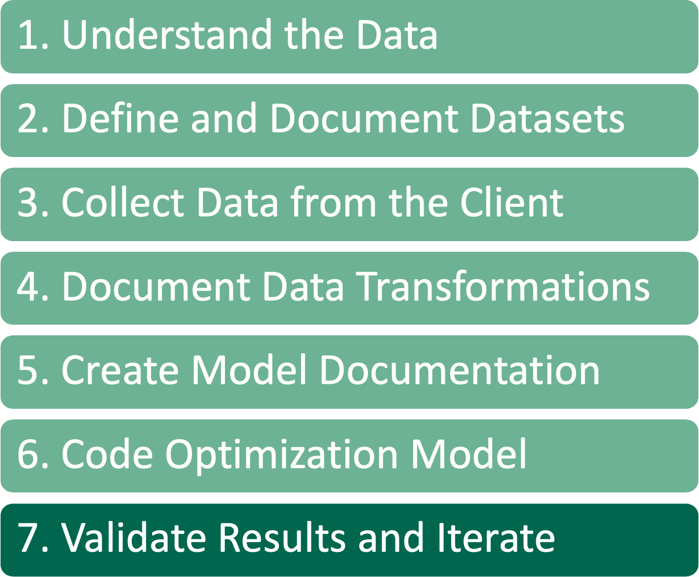
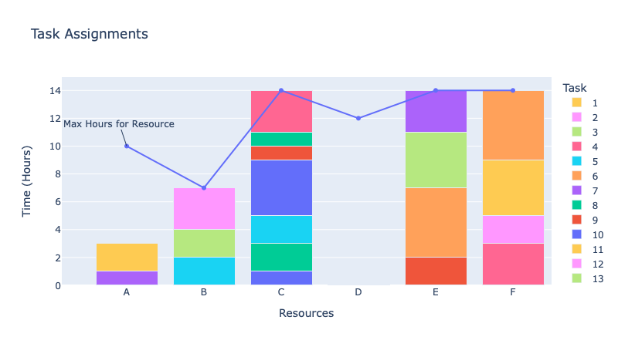

Review Results
For reviewing results, it helps to have a visual representation to enhance our understanding of the results and to review with clients
A tool that we like is plotly
The top plot here shows the assignment of the tasks to resources and how much time each resource is working, with another line for the max time for each resource
Bottom plot shows the resource group usage for tasks with separate lines for the min and max tasks
Don’t be surprised if the client hates the initial results
Most are bad at verbalizing what they really want/need. Therefore, iterating on solutions is very important

Slide 54
Solution Checker
Written by someone other than the modeler
Does not even need to be an optimization person
Model Solution is output as data frames
They can use the same data as input data
Do not copy, or preferably even look at, code written by the modeler
Only use the data and business rules documents should be used
Validates the constraints and value of the objective function

Slide 55
Development Tools
Here are some of the tools that we use, and recommend, for developing models
Anaconda – Package manager that allows for easy environment setup
pandas – Python library for data management
Visual Studio Code – Rich IDE with git (and svn) integration, along with many other extensions
We use pylance type checking as a tool inside Visual Studio Code to evaluate our python code for potential issues
mypy – Type checks code for potential issues
pytest – This is a testing harness in python that is straightforward to set up and create tests
Docstrings – Tool in python that allows for functions to describe their inputs and outputs as well as the intent of the function
Markdown – Used to create data and model documentation
Pandoc – Is used to generate PDF documents from the model documentation markdown
Jupyter – Used to analyze data and create proofs of concept
Solver APIs
gurobipy – Gurobi library for python development
docplex – IBM ILOG CPLEX and CPO library for python model development
xpress – FICO Xpress-MP library for python model development
ortools – Google OR-Tools library for python model development

Slide 56
Review
1. Understand the Data
2. Define and Document Datasets
3. Collect Data from the Client
4. Document Data Transformations
5. Create Model Documentation
6. Code Optimization Model
7. Validate Results and Iterate

Slide 57
Resources
Princeton blog post on rapid model development: https://www.princetonoptimization.com/blog/blog/princeton%E2%80%99s-rapid-optimization-model-development-approach-python-and-pandas
Demo code shown in this presentation: https://github.com/rrandall1471/2022-INFORMS-Demo

Slide 58

Questions

